Slide 1
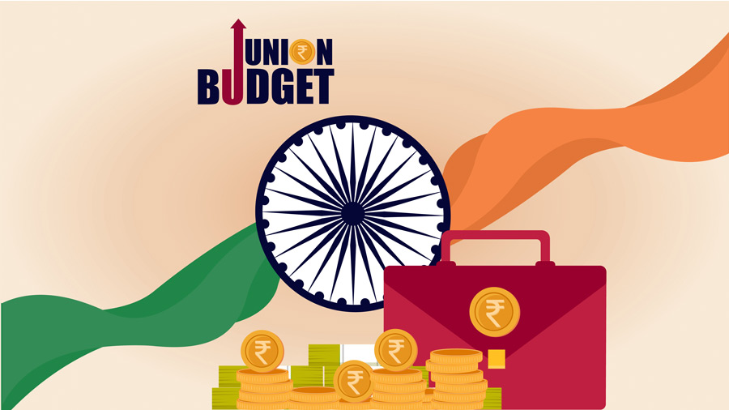
Presented by students of B.COM 1ST YEAR
SIMRANDEEP KAUR
AMRIT KAUR
SATWINDER KAUR
GAGANJOT KAUR

Slide 2
INTRODUCTION TO union budget
According to Article 112 of the Indian Constitution, the Union Budget of a year, also referred to as the annual financial statement, is a statement of the estimated receipts and expenditure of the government for that particular year.
Union Budget keeps the account of the government's finances for the fiscal year that runs from 1st April to 31st March.

Slide 3
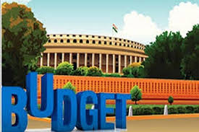
The budget has been broadcast live from Sansad Bhawan on the DD National, DD News and Sansad TV. It is hosted without interruption from 11:00 am to 1:00 pm, normally followed up with a report by a panel assessing the changes, benefits and flaws in the budget.

Slide 4
WHO PRESENTED UNION BUDGET
James Wilson, who presented India's first Union Budget was the finance member of the Indian Council and founder of the newspaper The Economist. The Union Budget for financial year 2025-26 is scheduled to be presented in parliament by finance minister Nirmala Sitharaman on February 1, 2025.
Since 26 november1947 total 76 times budget has been presented till 2024.

Slide 5
Purpose of union budget
This Budget continues our Government’s efforts to: a) accelerate growth, b) secure inclusive development, c) invigorate private sector investments, d) uplift household sentiments, and e) enhance spending power of India’s rising middle class.
Global and domestic best practices will be incorporated and appropriate technical and financial assistance will be sought from multilateral development banks. In Phase-1, 100 developing agri-districts will be covered. sing middle class.

Slide 6
Connections to Economic Growth
The budget helps plan how to use the country's resources to promote overall economic development and improve living standards. Resource Allocation: The budget ensures that resources are distributed in a way that addresses key priorities such as healthcare, education, infrastructure, and public welfare
Zero-poverty.
Hundred per cent good quality school education.
Access to high-quality, affordable, and comprehensive healthcare.
Hundred per cent skilled labour with meaningful employment.
Seventy per cent women in economic activities; and
Farmers making our country the 'food basket of the world'.

Slide 7
IMPACT ON INDIVIDUAL AND BUSINESSES
No income tax up to ₹12 lakh increases disposable income for taxpayers.
Positive for the automobile sector, especially two-wheelers and passenger vehicles, as higher disposable income could drive demand.
Consumer staple companies may benefit as increased rural and urban consumer sentiment is expected due to tax relief and agricultural scheme benefits.

Slide 8
The cotton productivity mission is positive for textile sector companies, including yarn and garment manufacturers.
The Dhan Dhanya Krishi Yojna will boost farm output and crop diversity, which is positive for agrochemical players.
Rural income improvements may also benefit the automobile sector, particularly in two-wheeler and passenger vehicle segments.

Slide 9
The Credit Guarantee Scheme now covers up to INR 10 crore for micro and small enterprises and INR 20 crore for startups. Additionally, Udyam-registered micro-enterprises can access credit cards with an INR 5 lakh limit.
The budget introduces transformative initiatives for skilling and higher education
Development of 50 tourist destinations through state partnerships via a “challenge mode.”

Slide 10
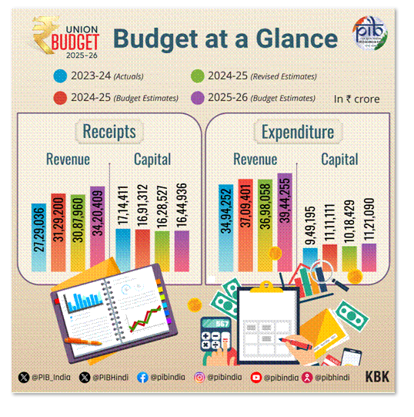

Slide 11
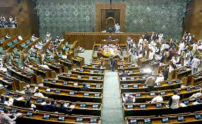
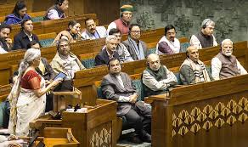
Role of Parliament in union budget

Slide 12
Role of Parliament in Union Budget
The Parliament Budget Session 2025 (Jan 31 - Apr 4) will introduce 16 new Bills and review 13 key legislations, including the Finance Bill, Waqf (Amendment) Bill, and Immigration and Foreigners Bill.
Major discussions will focus on economic policies, taxation reforms, banking regulations, and disaster management, shaping India’s fiscal and legislative framework.

Slide 13
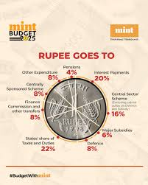

Slide 14
DIFFERENCE BETWEEN CURRENT BUDGET AND PREVIOUS BUDGET
CURRENT BUDGET
The net tax receipts are estimated at ₹28.37 lakh crore.
The fiscal deficit is estimated to be 4.4 per cent of GDP.
The gross market borrowings are estimated at ₹14.82 lakh crore.
PREVIOUS BUDGET
Total revenues stood at ₹171.15 crore, and the fiscal deficit was ₹24.59 crore.
The total expenditure was estimated at ₹197.29 crore with Defence expenditure at ₹92.74 crore.

Slide 15

THANK YOU

